Slide 1
Test task (Data Scientist) Yushkevich Natallia CV: https://drive.google.com/file/d/1qmeZXf1taQ8C_zPMA_upfHYp1zQlURjg/view?usp=sharing Project: https://github.com/YushkevichNV/A1-tasks

Slide 2
Task 1.
Using historical data , build a time series model.
Predict the daily behavior of the series in the next 3 months.
Explain the choice of the forecasting method.
Give an estimate of the forecast quality.

Slide 3
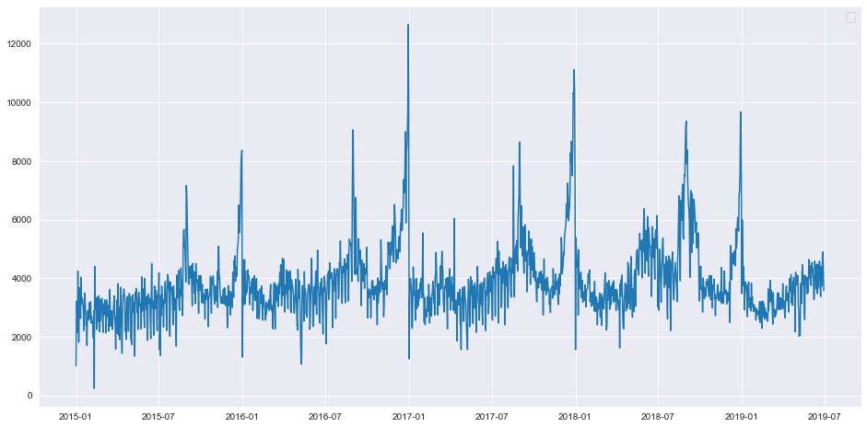
Task 1.
The data is displayed as a time series, where the x-axis is the day and the y-axis is the quantity.
Fig. 1.1 - Time series

Slide 4
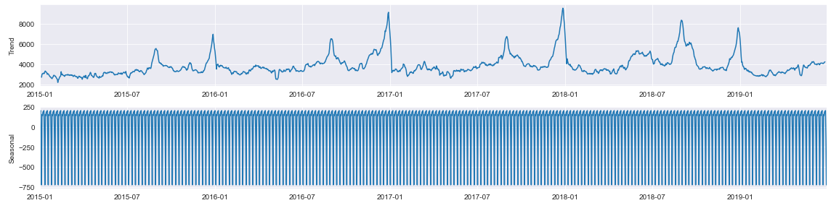
Task 1.
The graph does not show any trend or seasonality (fig. 1.2). This suggests that the time series is stationary.
Fig. 1.2 - Components of the time series

Slide 5
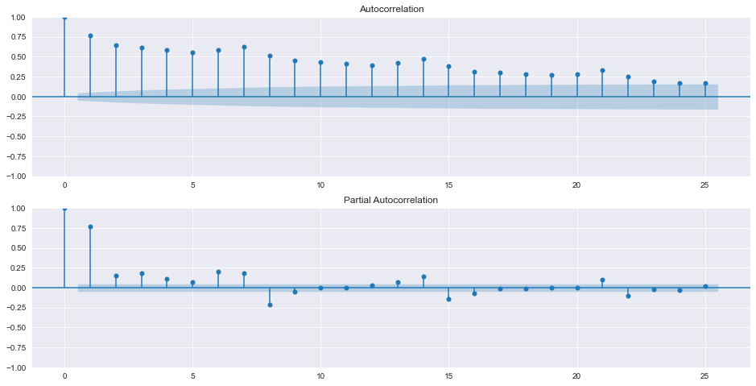
Task 1.
Fig. 1.3 - ACF, PACF

Slide 6
Task 1.
The Dickey-Fuller test showed that p-value = 0,000002.
p-value < 0.05, so the time series is stationary.
The PACF (fig. 1.3b) plot has a significant spike at lag 1 and less significant at p = [2; 8]. The ACF (fig. 1.3a) plot fades more smoothly. This may suggest an ARIMA(p, d, 0) model, where p can be taken from 1 to 8.
Since the series is stationary, d = 0.
Split the data into training and validation data:
train_df = df[:'2019-03-31']
test_df = df['2019-04-01':]

Slide 7
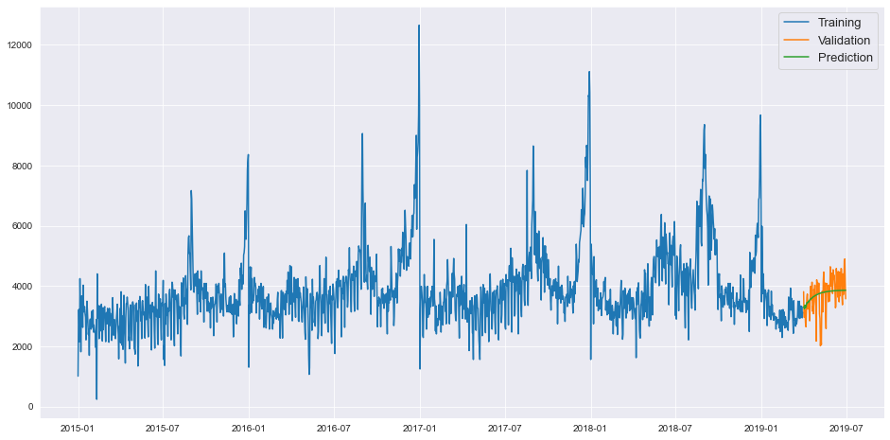
Task 1.
We trained the model ARIMA(8, 0, 0).
Metrics: MAPE = 12,77%, MAE = 414,17, MSE = 312250,57.
Fig. 1.4 - Training, valiudation and prediction

Slide 8
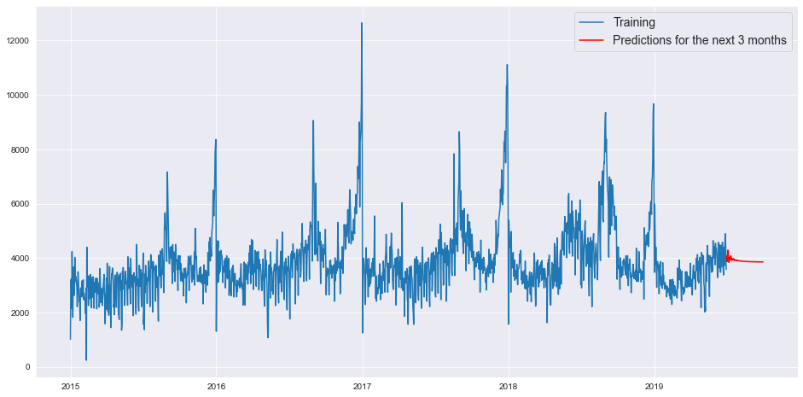
Task 1.
Fig. 1.5 - Finaly result

Slide 9
Task 2.
Predict the values of the Target variable for the data set on the "Validate" sheet.
Explain the choice of method.
Give estimates of accuracy and quality of the predictive model.
Construct an ROC-curve.
Name the three most important predictors.

Slide 10
Task 2.
Preliminary analysis.
Training datase has 10 000 rows.
Validation dataset has 20 000 rows.
No duplicate rows.
All data is of type ‘float64’ or ‘int64’.
No uninformative data.
There is no accompanying documentation for the data, so the column values remain unclear.
Target has values 0 or 1 (binary classification).
There is no class imbalance.

Slide 11
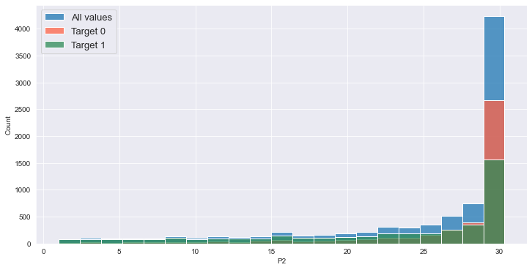
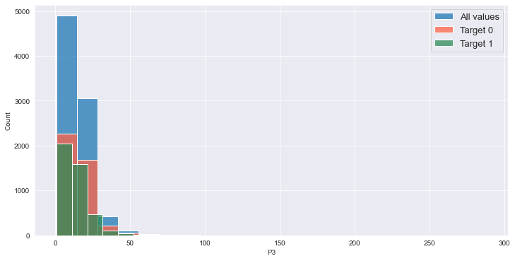
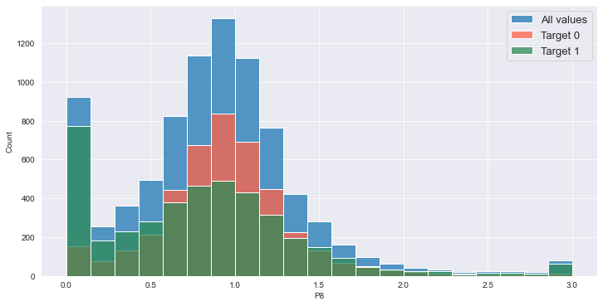
Task 2.
Missing values:
P2 - 14.92 %
P3 - 14.85 %
P8 - 15.11 %

Slide 12
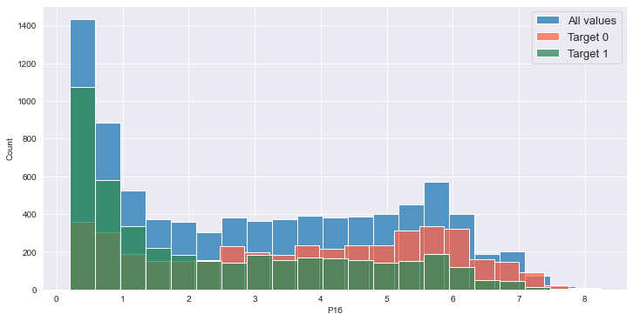
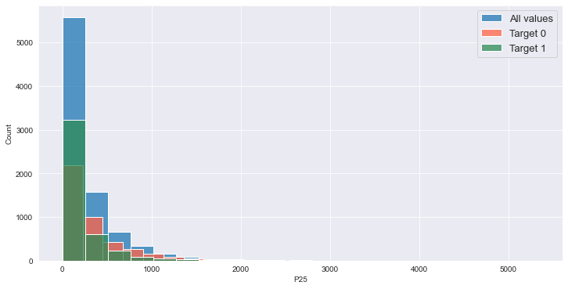
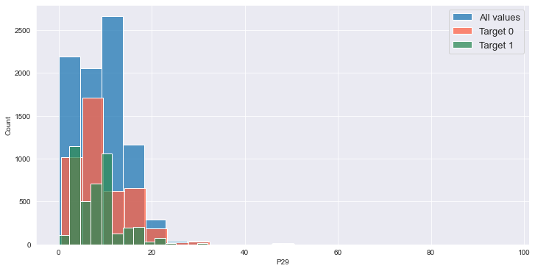
Task 2.
Missing values:
P16 - 15.09 %
P25 - 15.08 %
P29 - 15.15 %

Slide 13
Task 2.
Missing values:
We can say that the shapes of the histograms for the different target variables are similar.
All distributions have offsets, so it is better not to replace the mean of the omissions.
Replace the missing values with the median.

Slide 14
Task 2.
Correlating features:
P1 → P5
P17 → P25
P22 → P23
Delete the column P5, because P1 more informative.
We leave the other columns in the dataset.

Slide 15
Task 2.
Model building:
Use QuantileTransformer to make the data more even.
We solve the problem of binary classification (classes are balanced).
Binary classification approaches are usually similar to logistic regression models. We can also use the method of gradient descent.
To evaluate the quality of the model we will use ROC-AUC (area under the error curve).

Slide 16
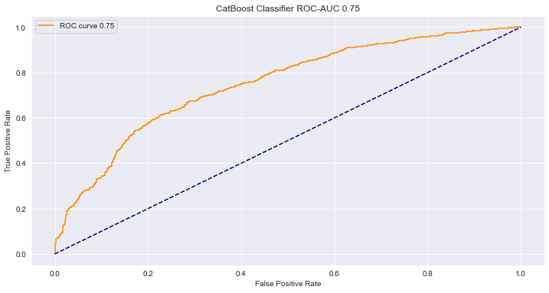
Task 2.
Baseline model CatBoostClassifier():
accuracy = 0.688
precision = 0.687
recall = 0.692
f1= 0.689
roc-auc = 0.749

Slide 17
Task 2.
Selection of model parameters.
For the selection of model parameters we used GridSearchCV.
The best parameters:
depth = 7,
iterations = 1000,
l2_leaf_reg = 2,
learning_rate = 0.01

Slide 18
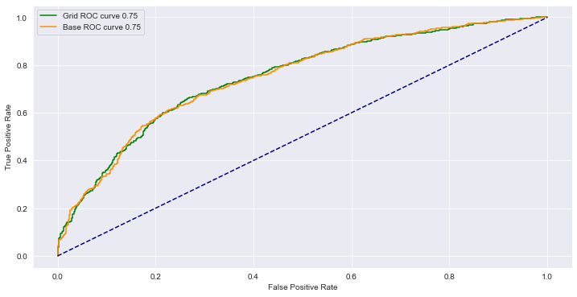
Task 2.
CatBoostClassifier( depth = 7, iterations = 1000, l2_leaf_reg = 2, learning_rate = 0.01):
accuracy = 0.690
precision = 0.686
recall = 0.698
f1= 0.692
roc-auc = 0.750
All metrics have improved.

Slide 19
Task 2.
The three most important predictors.
We used ‘SHAP’ to find the most important features. The SHAP library calculates Shapley values to estimate the importance of a feature. To estimate the importance of a feature, the predictions of the model with and without the feature are evaluated.
Top 3 predictors with a coefficient of significance:
P16 - 0.314024
P10 - 0.203953
P23 - 0.187523

Slide 20
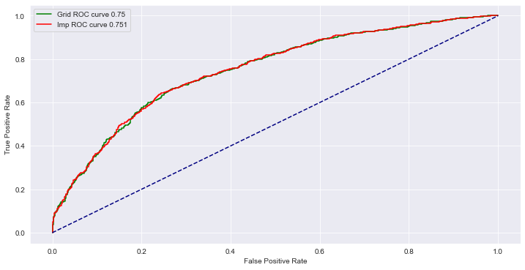
Task 2.
Let's train the model CatBoostClassifier( depth = 7, iterations = 1000, l2_leaf_reg = 2, learning_rate = 0.01) with features with a significance coefficient greater than 0.02.
accuracy = 0.692
precision = 0.692
recall = 0.690
f1= 0.691
roc-auc = 0.751
All metrics (except f1) have improved.

Slide 21
Task 2.
Final model:
CatBoostClassifier(depth = 7, iterations = 1000, l2_leaf_reg = 2, learning_rate = 0.01)
Features with a significance coefficient greater than 0.02.

Slide 22
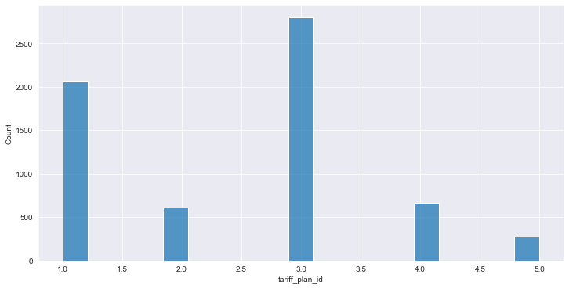
Task 3.
1. Directions for tariff plan changes.
Tariffs from which were switched and numbers of transitions:
1: 2059
2: 609
3: 2800
4: 662
5: 276
Fig. 3.1 - From which tariff plans there were transfers.

Slide 23
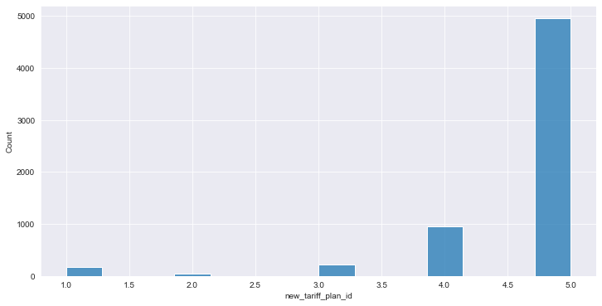
Task 3.
Tariffs to which the transition was madeand numbers of transitions:
1: 165
2: 41
3: 224
4: 958
5: 4952
Fig. 3.2 - To which tariff plans the transition was made.

Slide 24
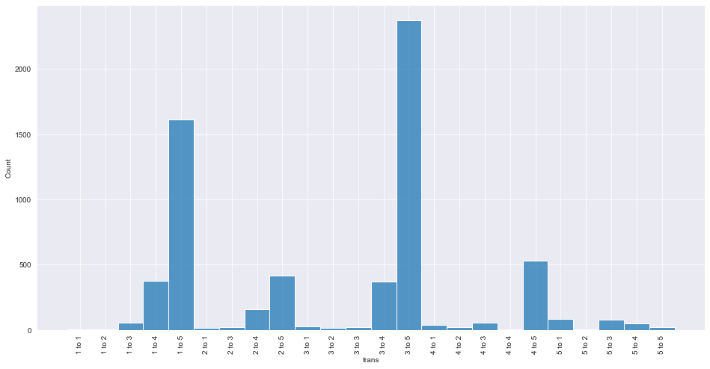
Task 3.
Fig. 3.3 - Transitions

Slide 25
Task 3.
2
1
1
1
1
5
13
28
37
81
3
3
2
2
2
55
20
12
20
4
1
2
3
4
5
378
158
367
56
75
4
4
4
3
3
1613
417
2372
528
49
5
5
5
5
4
Fig. 3.4 - Number of transitions

Slide 26
Task 3.
From the diagrams in fig. 3.3, 3.4 we can see that more often transitions were from tariffs with a smaller id to a tariff with a larger id.
From this we can conclude that each successive plan is better than the previous one.
The least number of conversions was from tariff 5 (fig. 3.2).
From tariff 3 and 1 there were the most number of transitions (fig.3.1).
There are transitions to the same plan (fig. 3.3). This indicates that the subscriber stopped using the services, but then came back.
The most often transitions are: 3 → 5 (2372), 1 → 5 (1613), 4 → 5 (528).

Slide 27
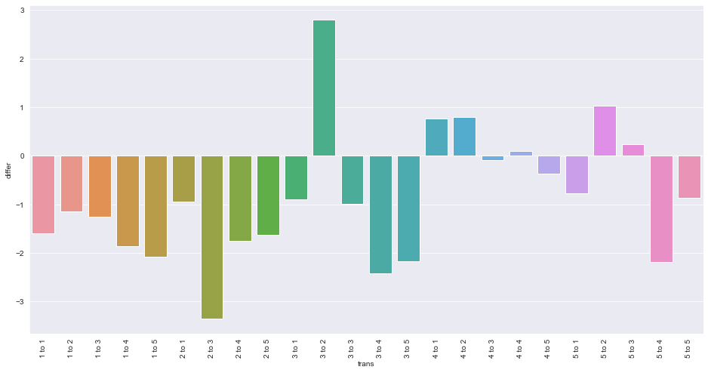
Task 3.
2. How much the average monthly bill of subscribers has changed?
Fig. 3.5 - How much has changed in the average monthly bill of subscribers.

Slide 28
Task 3.
1 to 1 | -1.591583
1 to 2 | -1.139267
1 to 3 | -1.260509
1 to 4 | -1.852773
1 to 5 | -2.070950
2 to 1 | -0.946949
2 to 3 | -3.348283
2 to 4 | -1.753408
2 to 5 | -1.634030
3 to 1 | -0.898202
3 to 2 | 2.793472
3 to 3 | -0.984714
3 to 4 | -2.412072
3 to 5 | -2.176663
4 to 1 | 0.760396
4 to 2 | 0.801367
4 to 3 | -0.093776
4 to 4 | 0.093167
4 to 5 | -0.366195
5 to 1 | -0.775825
5 to 2 | 1.023000
5 to 3 | 0.231436
5 to 4 | -2.191085
5 to 5 | -0.869030
Table 1. Changes in average bill over a three-month period

Slide 29
Task 3.
The directions of tariff plan changes, which are characterized by an increase in the average bill in the three-month period: 3 → 2, 5 → 2, 4 → 2, 4 → 1, 5 → 3.
The directions of tariff plan changes, which are characterized by an reduction in the average bill in the three-month period: 2 → 3, 3 → 4, 5 → 4, 3 → 5, 1 → 5, 1 → 4, 2 → 4, 2 → 5, 1 → 3, 1 → 2, 2 → 1, 3 → 1, 5 → 1, 4 → 5, 4 → 3.
The most expensive plan is 2.
The most cheep plan is 4.

Slide 30
Task 3.
Subscribers usually switched to a tariff plan with a smaller bill.
Some people prefere to a more expensive tariff plan (3 → 2). Maybe the plan 2 includes more services then 3.
From the fig. 3.3 we can see that a small number of people prefere more expensive tariff plan.
Total bill change: -1.826

Slide 31
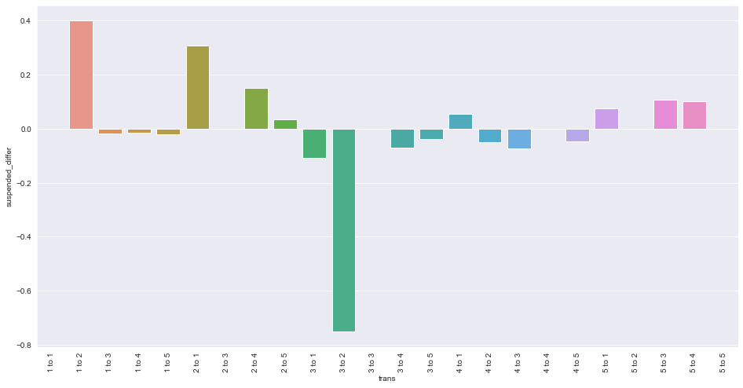
Task 3.
3. Changing the blocking frequency
Fig. 3.5 - Changing the blocking frequency

Slide 32
Task 3.
1 to 2 | 0.4
1 to 3 | -0.01818182
1 to 4 | -0.01587302
1 to 5 | -0.02107874
2 to 1 | 0.30769231
2 to 3 | 0
2 to 4 | 0.15189873
2 to 5 | 0.03597122
3 to 1 | 0.10714286
3 to 2 | -0.75
3 to 4 | 0.07084469
3 to 5 | -0.03794266
4 to 1 | 0.05405405
4 to 2 | 0.05
4 to 3 | 0.07142857
4 to 5 | 0.04545455
5 to 1 | 0.07407407
5 to 2 | 0
5 to 3 | 0.10666667
5 to 4 | 0.10204082
Table 2. Changing the blocking frequency

Slide 33
Task 3.
The number of blockages has increased: 1 → 2, 2 → 1, 2 → 4, 5 → 3, 5 → 4, 5 → 1, 4 → 1, 2 → 5
The number of blockages has decreased: 3 → 2, 3 → 1, 4 → 3, 3 → 4, 4 → 2, 4 → 5, 3 → 5, 1 → 5, 1 → 3, 1 → 4.
The number of blockages has not changed: 5 → 2, 2 → 3.
General average change in the level of blockages -0.021.
We can say that the number of blockages has not changed significantly.

